Slide 1


Pratima
Bunze
Moudie
Naincy

Slide 2
COMPANY OVERVIEW
We propose to build up a database framework that holds track of stock in the kitchen or back of the house and updates it as per everyday sales.
Every food item is related to corresponding ingredients and as every item is sold the ingredients applied in making that item are likewise used. These varieties in stock are monitored through utilizing a database.
We propose to monitor every food ingredient by interfacing it to the item and therefore make a reliant association with that item.
At a period apparently, the weeks end; if the inventory is lower than the threshold level, request structures to the merchants or vendors are produced in order to stock the necessary things for a continuous week.
The task moreover makes reasonable expectations of required stock for the resulting week principally dependent on the foreseen atmosphere and the achievable events or occasions that may impact near future deals.
Toward the weeks end the database framework considers all limit levels, forecasts and other various components to create a request structure that when confirmed by the manager is disseminated to the merchants.

Slide 3
PROBLEM DEFINED
Catering is one such alternative that's simply forgotten or utterly avoided.
Adding a catering concept shouldn’t be checked out in and of itself a foul issue.
Catering could be a way for restaurant owners to usher in extra cash.
Silver Diner recently added a catering menu to accommodate larger groups and offices close by.
The most drawback is that the order doesn’t go on to the Point Of Sales (POS) System.
To stay track of the inventory of catering orders, Silver Diner should calculate and analyze necessities for the longer-term manually that takes up loads of their time and human effort and is additionally vulnerable to human error.
This poses a tangle of a scenario that the employees at Silver Diner in addition to several alternative restaurants faces. It takes up loads of your time to manually keep track of sales and place correct orders to vendors, wasting helpful labor in trivial works.

Slide 4
PROJECT SCOPE
runs on the rudimental conception that each item will be linked to its required supplies which are stored in a catering inventory database
aims at providing an efficient interface to the restaurants for managing their grocery inventory predicated on each item sold
system analyzes the total sale of menu items and proportionately deducts the congruous amount from the resource database
If it finds that certain ingredients are below the threshold, it will engender a purchase order for those item(s) and send it to the manager (admin) for approbation
system will withal ascertain groceries are tracked correctly, timely orders will be sent out to the vendors or suppliers, and the inventory will always be maintained and updated
system will enable restaurant owners to be able to ken the type of pabulum their customers relish, the time most aliment is consumed and the type of ailment that is not popular with the customer. The system will additionally keep track of the shelf life of resources. If any product or supply is about to expire the system will apprise the manager or owner, the details of the quantity that is near its expiration date.

Slide 5
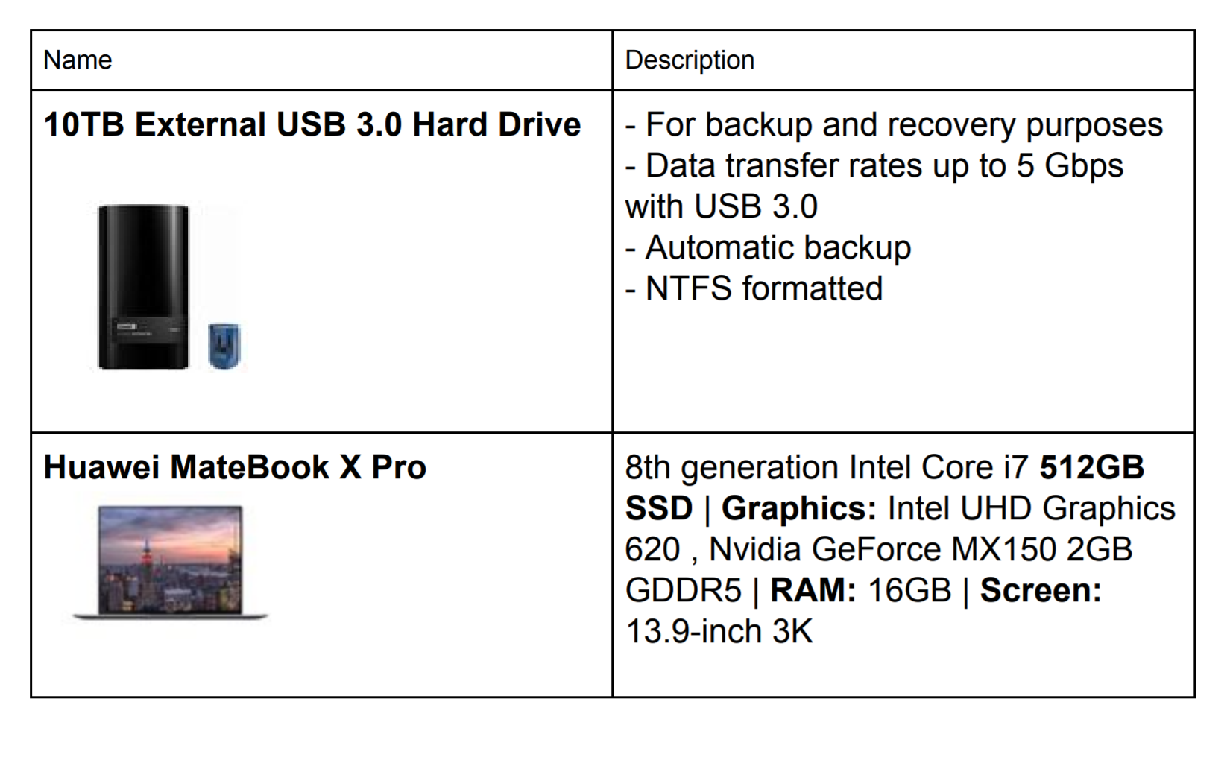
HARDWARE REQUIREMENTS

Slide 6
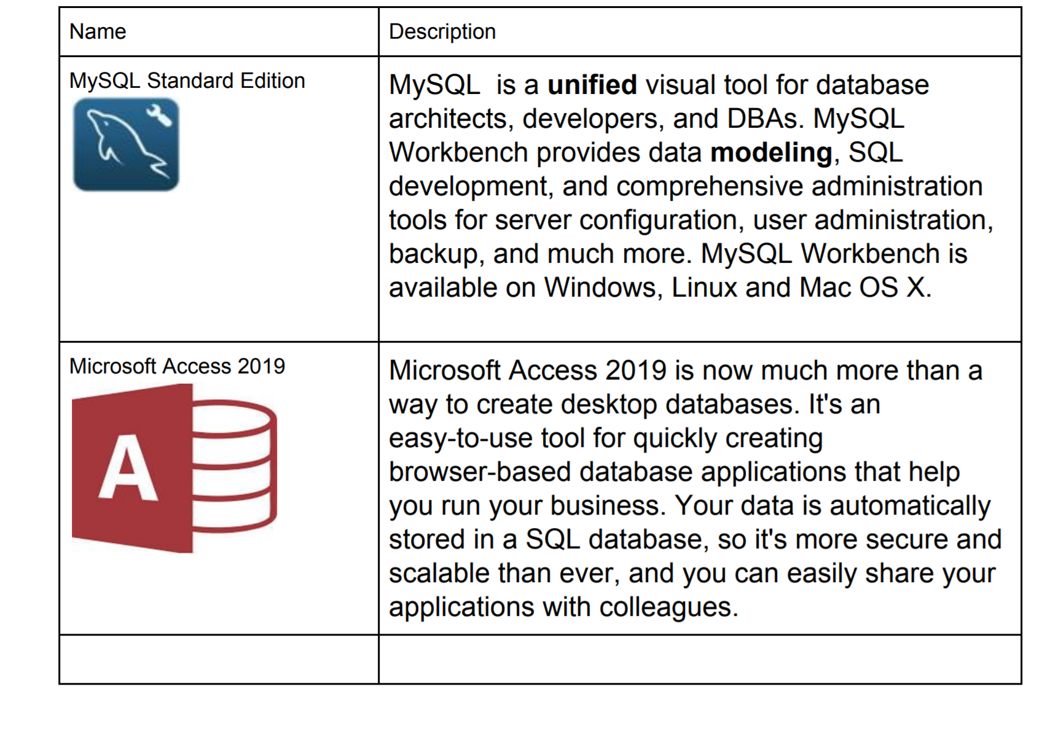
SOFTWARE REQUIREMENTS

Slide 7
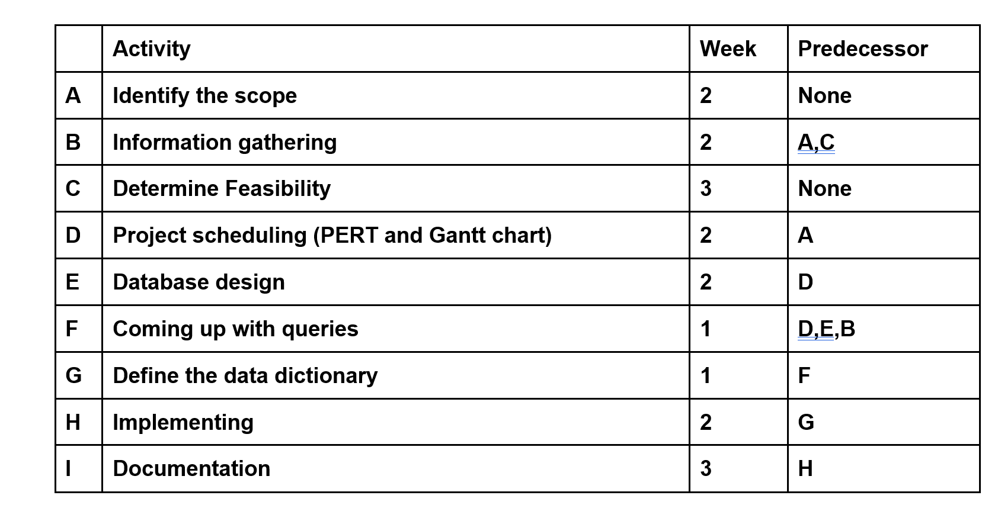
ACTIVITY TABLE

Slide 8
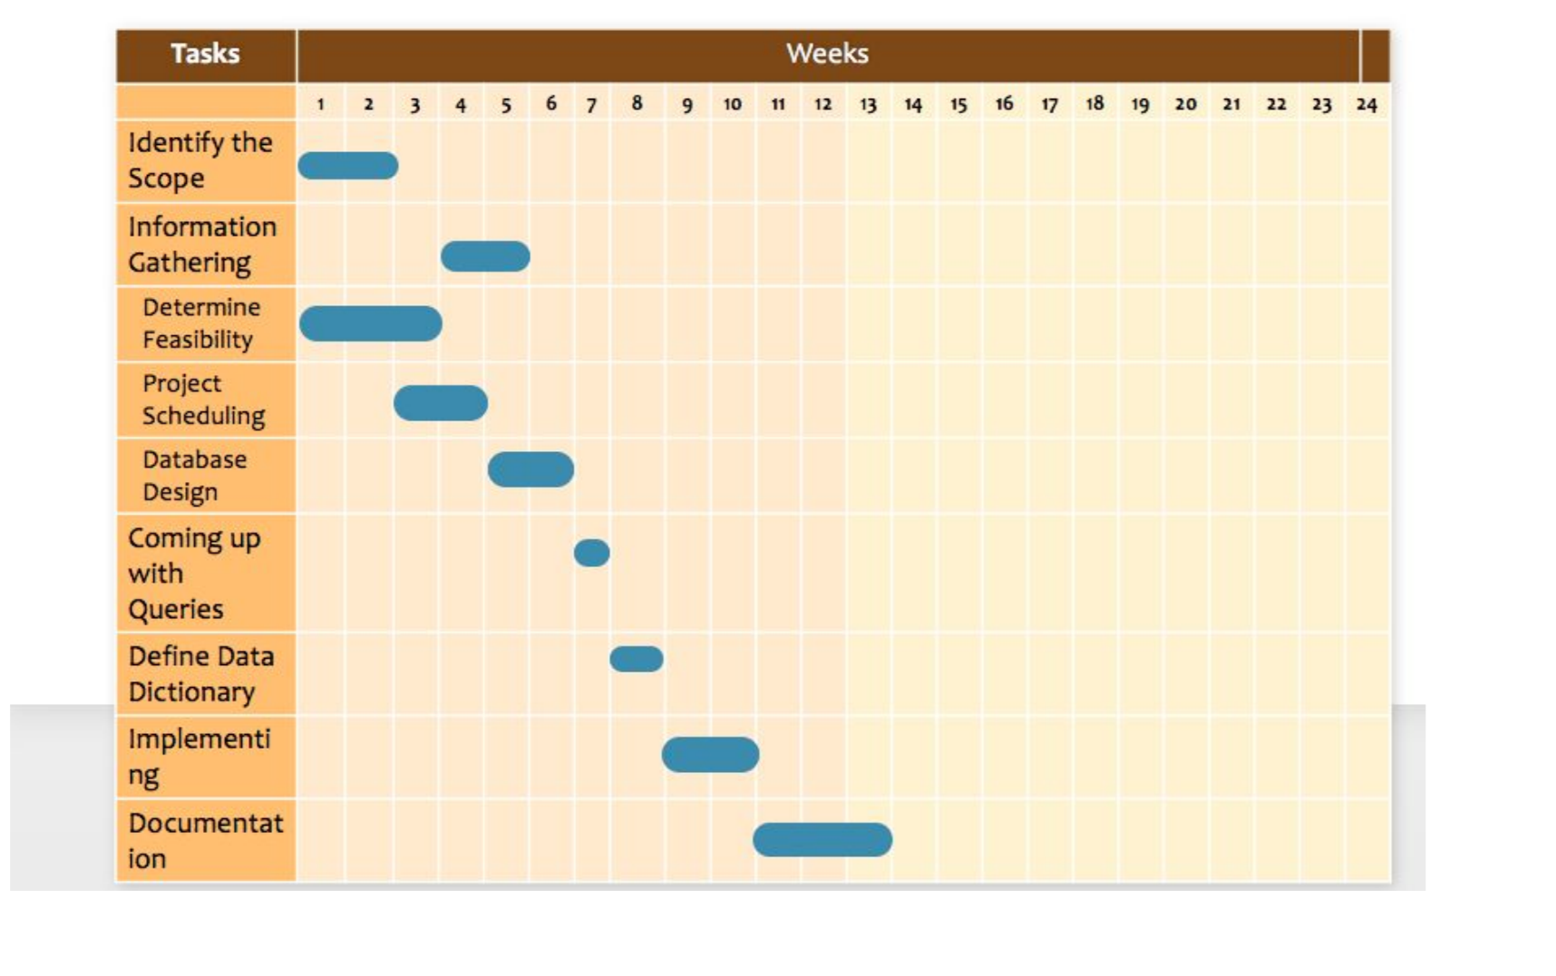
GANTT CHART

Slide 9
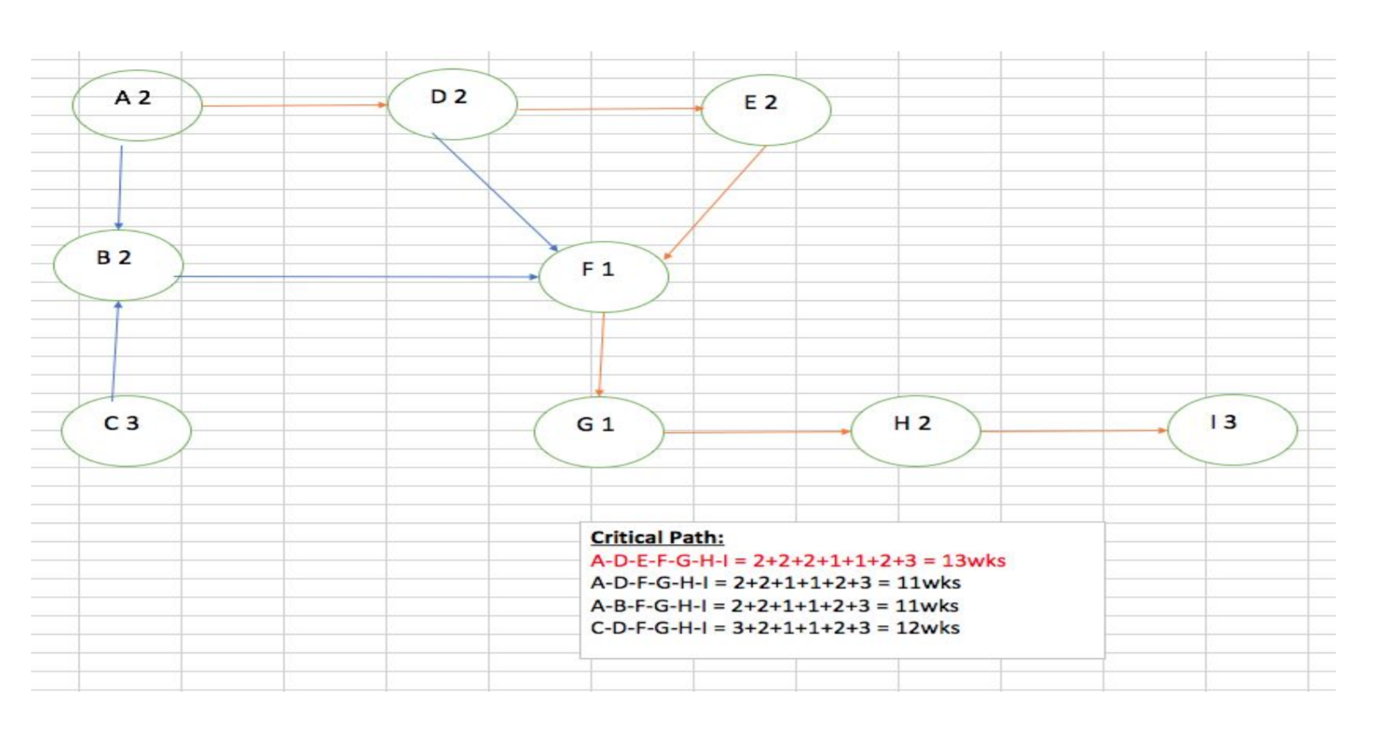
PERT DIAGRAM

Slide 10
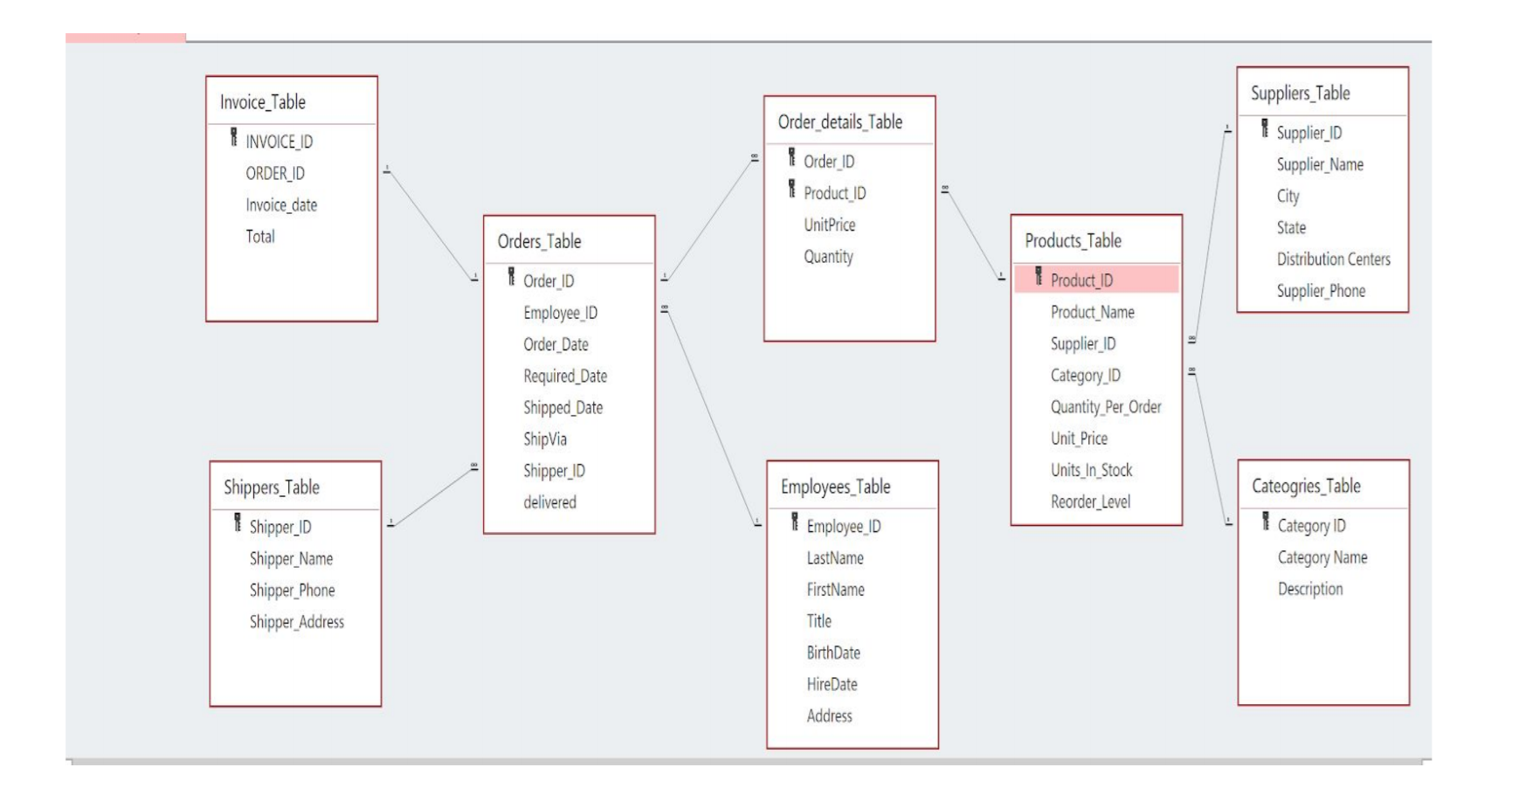
E-R DIAGRAM

Slide 11
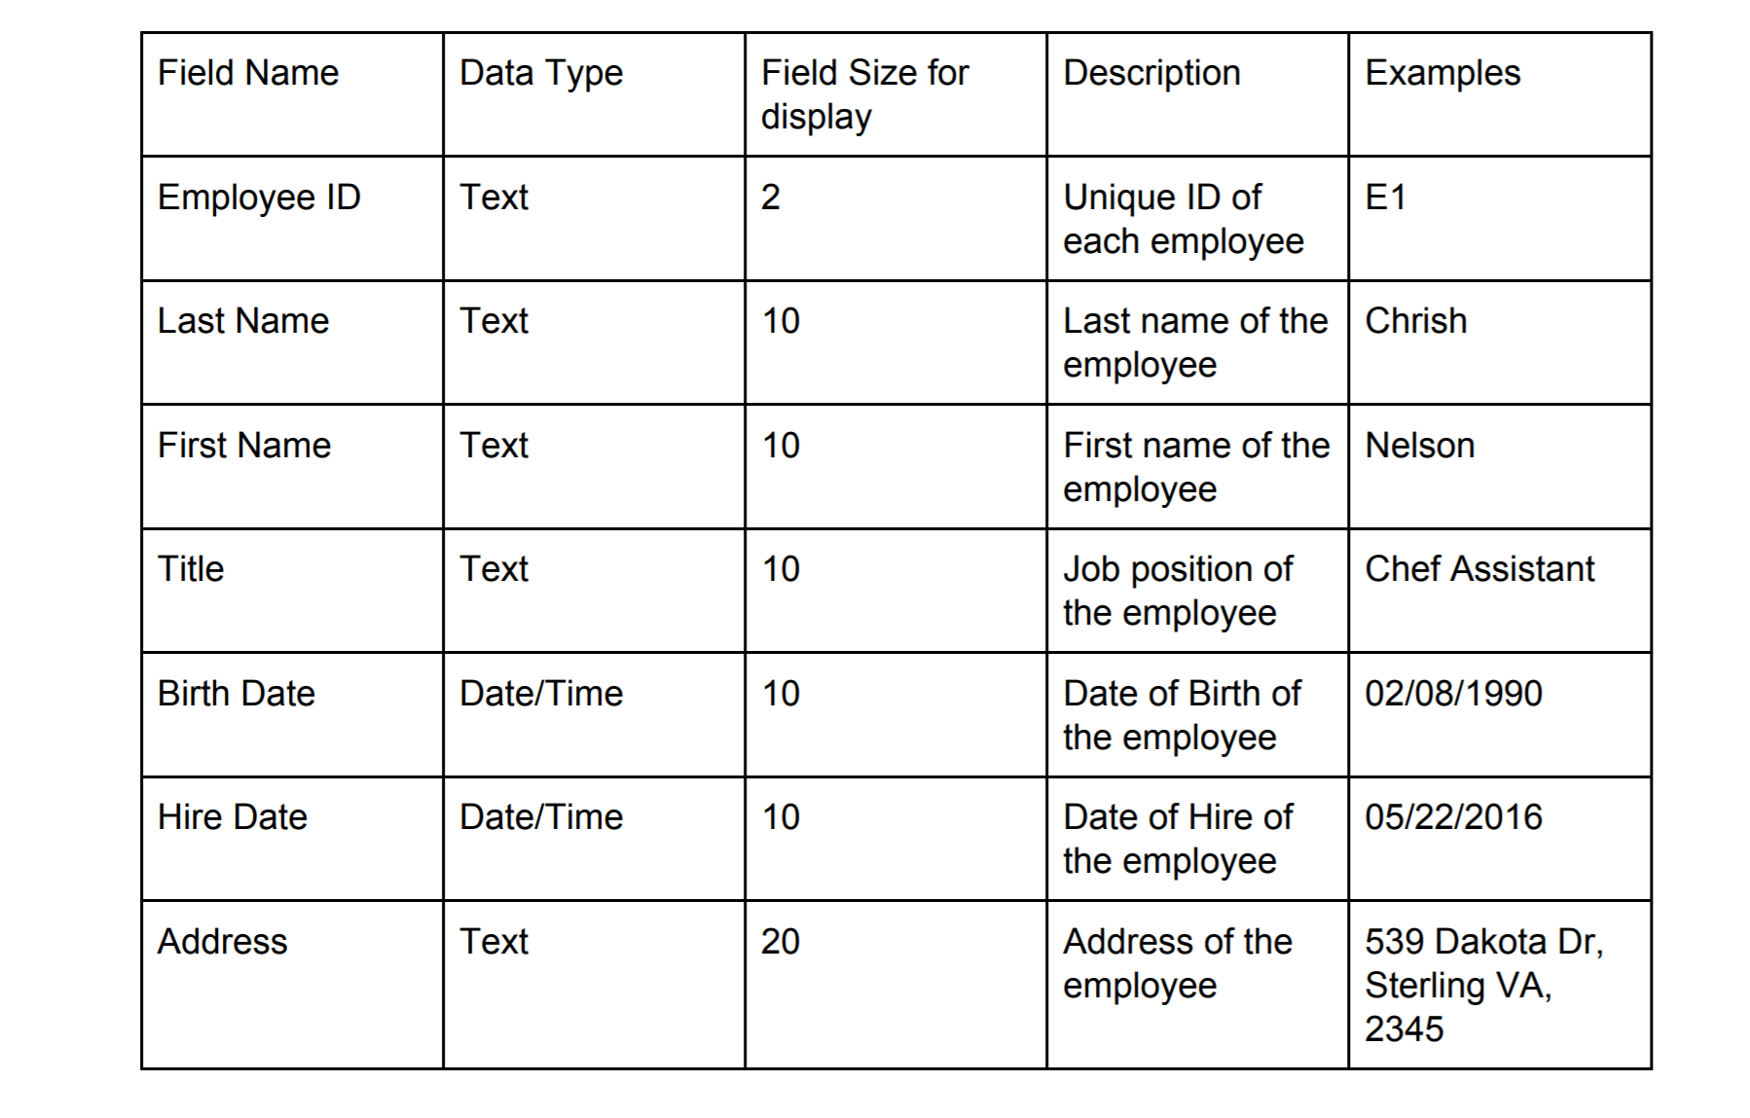
DATA DICTIONARY

Slide 12
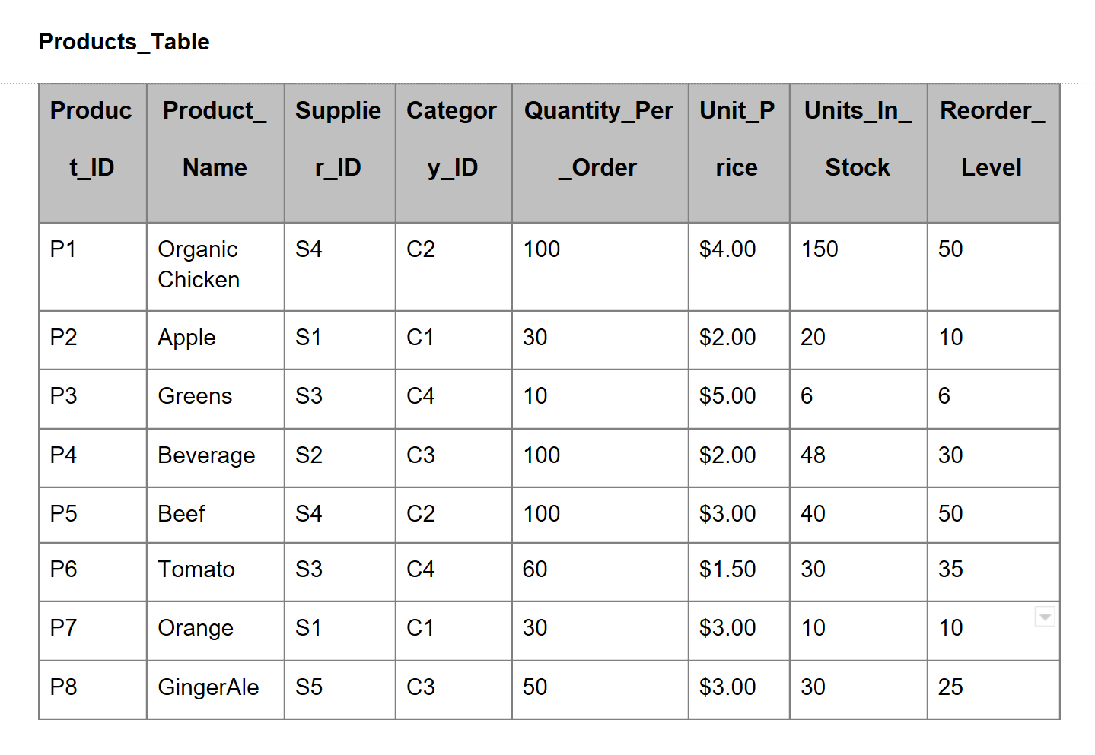
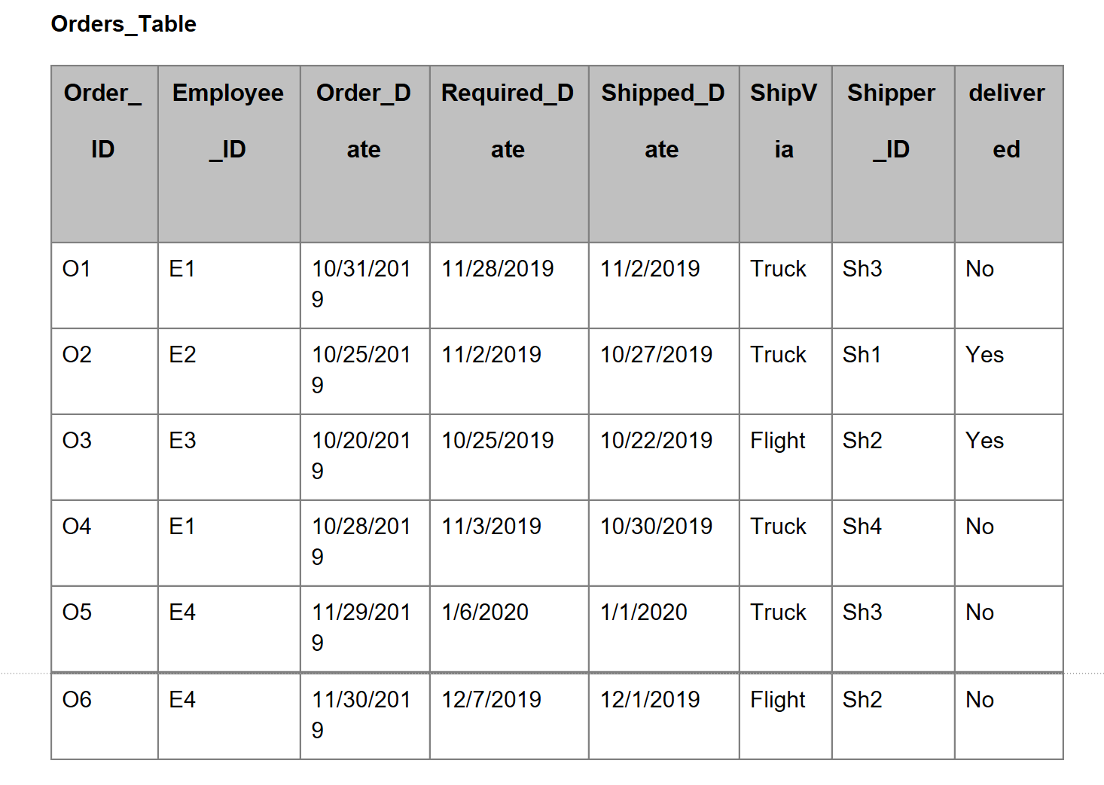
Tables

Slide 13
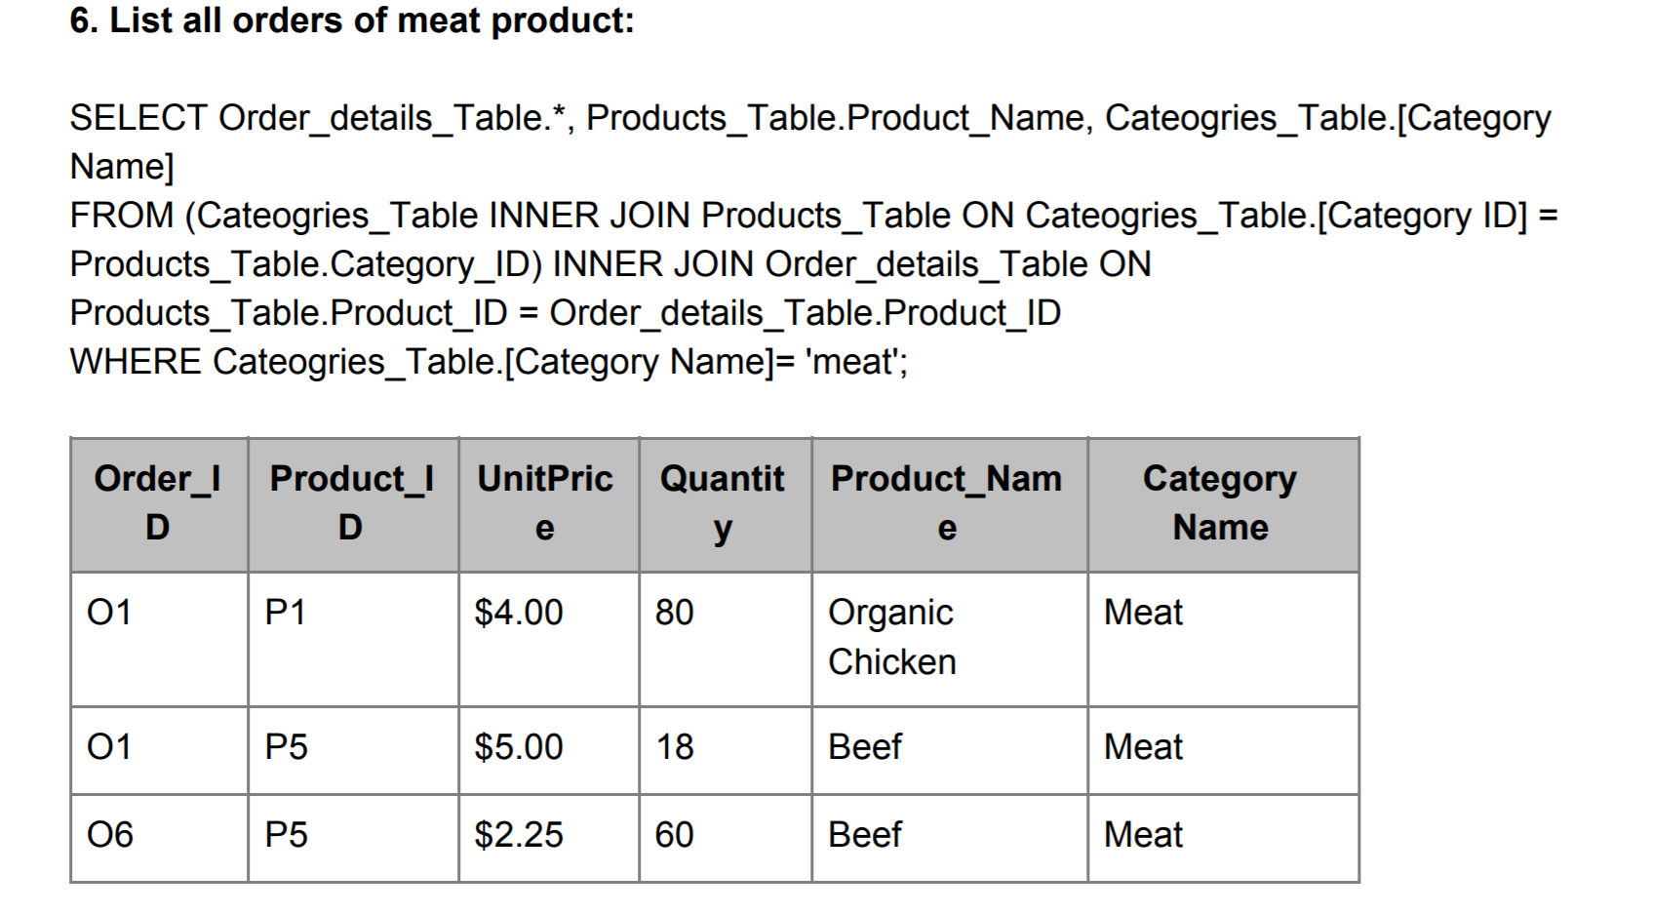
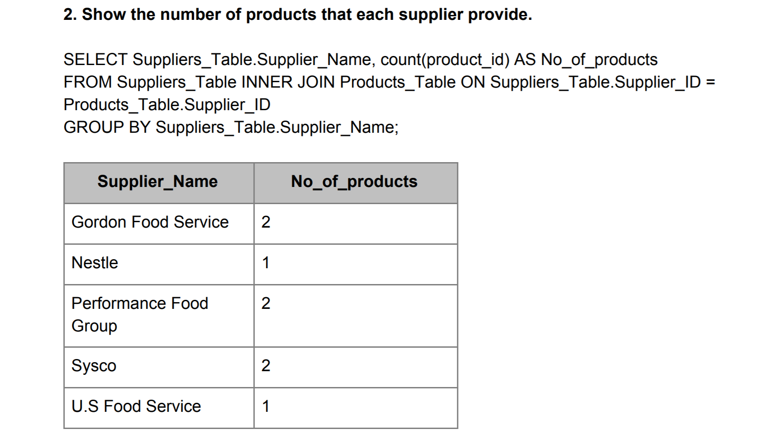
QUERIES

Slide 14
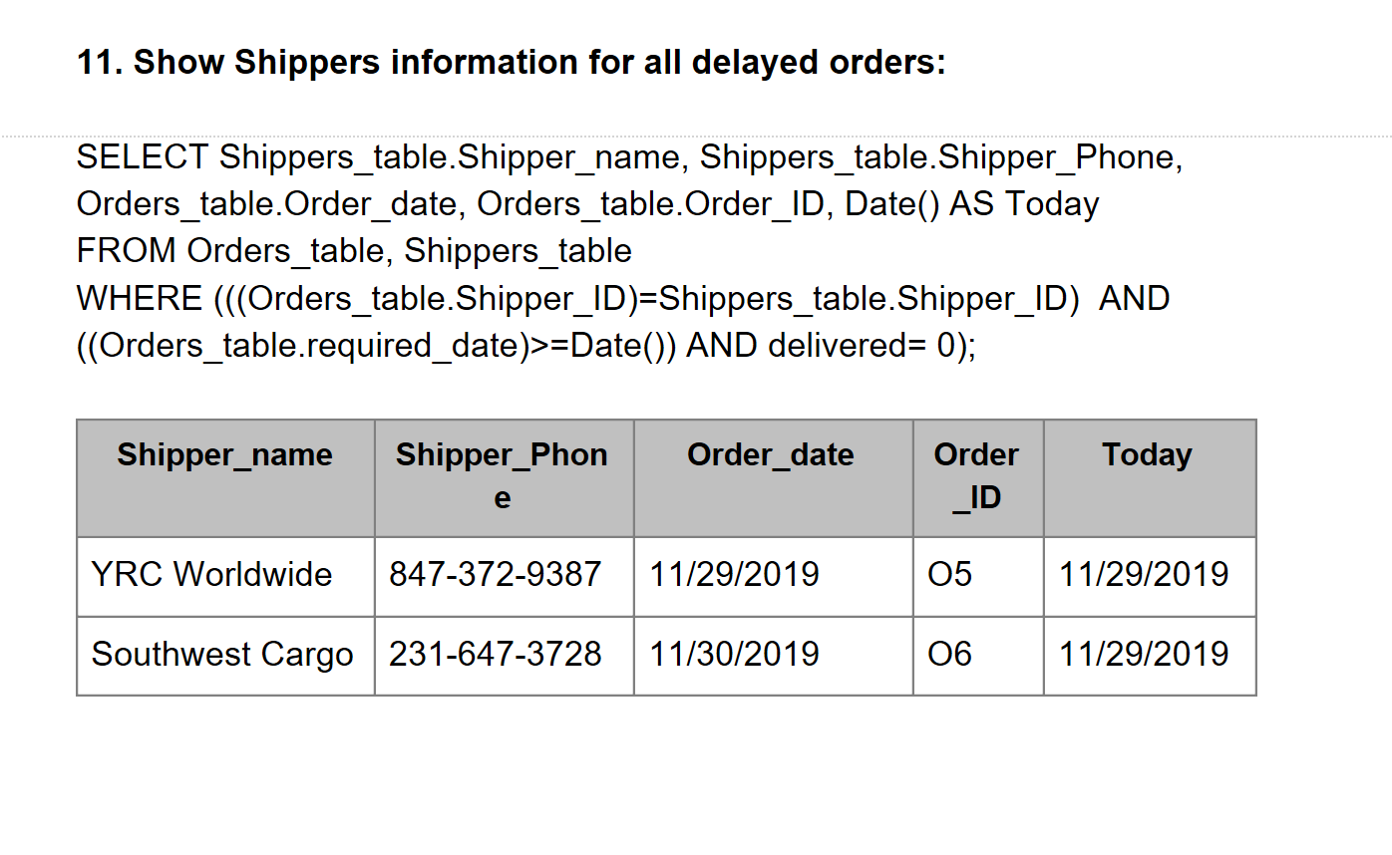
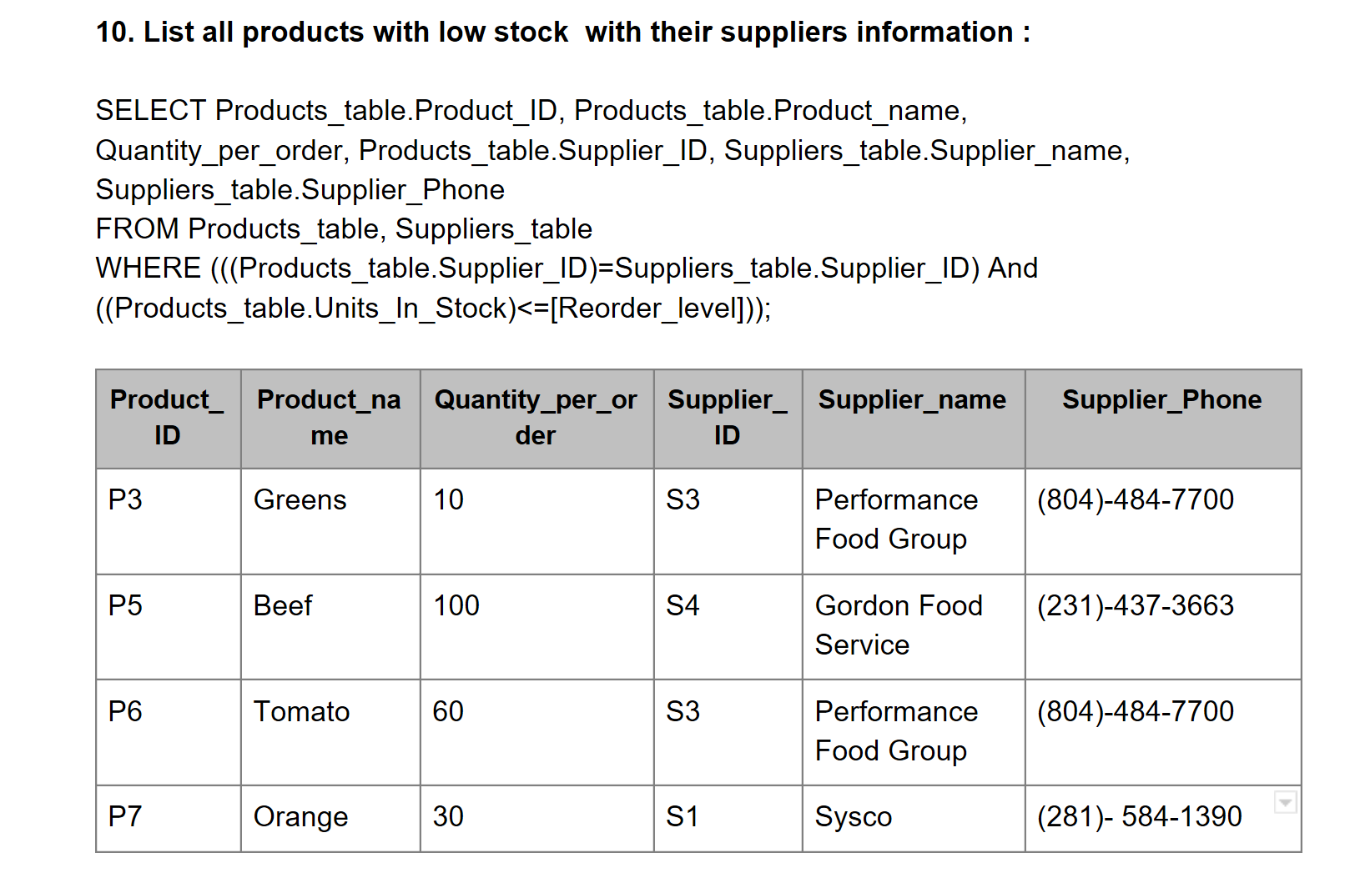
Queries

Slide 15
PROJECT CHALLENGES
Managing time
Gathering
Designing
Identifying

Slide 16

THANK YOU

